Slide 1
数据分析与机器学习 – 6
李大威
daweili@dhu.edu.cn

Slide 2
PCA – another representation
To faithfully restore the original data after dimensionality reduction (P.146第二句话):
z_{i} is the orthographic projection (正投影) of x_{i}.
T is an orthogonal matrix:
Compute the square error between x_{i} and the back-mapped z_{i}
tr : Trace (迹)
: Reduced D matrix

Slide 3
PCA – another representation
Objective: Minimize the error:
Consider the eigenvalue of matrix C_{x}.
The reduced D matrix:

Slide 4
LPP – Locality Preserving Projections （局部保持投影 2005, 何晓飞, 浙江大学, University of Chicago ）
Essence: Keep local similarity during dimensionality reduction
Gaussian similarity:
K-NN (Nearest Neighbors) similarity (Sparsity):
Local scale similarity:
x_{i} is the kth nearest point to x_{i}

Slide 5
LPP – Locality Preserving Projections （局部保持投影 2005, 何晓飞, 浙江大学, University of Chicago）
Objective:
Divide it into two parts：
It is obvious that T=O is a degenerate solution (退化解). To avoid it, a constraint needed:
Why minimization!?
Big but almost fixed
Small
Small near 0
Bounded
Smaller the better
Smaller the better
“Generalized” orthogonality 广义正交性

Slide 6
LPP – Locality Preserving Projections （局部保持投影 2005, 何晓飞, 浙江大学, University of Chicago）
D is a diagonal matrix:
Let：
Then:
The final Objective of LPP:
Consider the “generalized” eigenvalue problem of
Why minimization!?
形如：

Slide 7
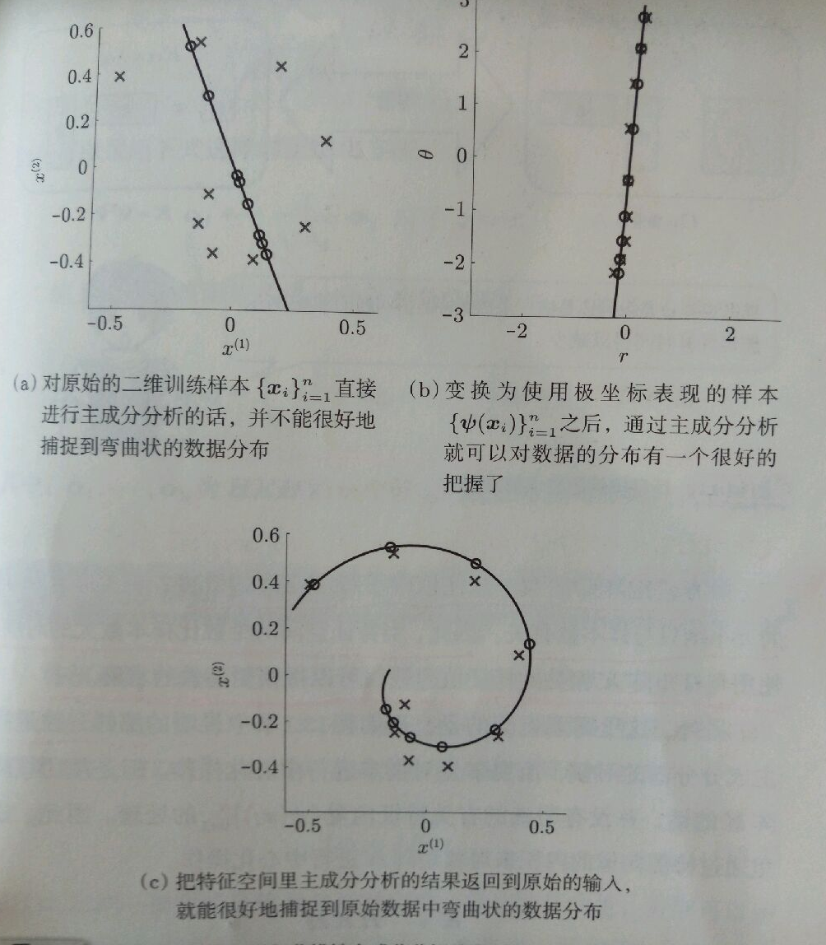
Non-linear PCA （非线性主成分分析）
A case study (The original PCA fails):
fail
PCA
Non-linear
mapping
Correct
PCA
Non-linear
back-mapping
Approximate

Slide 8
Kernel PCA（核函数主成分分析）
PCA: a eigenvalue decomposition of C_{x}：
The problem：sometimes data is high-dimensional：
维数m
数据点个数n
Linear Kernel

Slide 9
Centralization of Kernel PCA （核函数主成分分析的中心化）
Centralization of ：
Normalization of eigenvectors ：
In which
修改书上该公式
a₁,…,a_{m}对应最大的m个特征值

Slide 10
Laplacian Eigenmaps - LE （拉普拉斯特征映射）
Essence: combine Kernels with LPP：
Solutions：
If W is sparse, then L=D-W is also sparse. The solution is highly efficient.
We find a degenerate solution:

